Slide 1
Building, Running, Patching Docker Containers – The Paradigm Shift
Steve Lasker
Program Manager – Azure Developer Experiences
@stevelasker
Notes:
Building Resilient Microservices with .NET Core and Azure Container Services (AKS)
Code: BRK2141
Type: Breakout 45 minute
Track(s): Applications and Infrastructure
Speaker(s): Glenn Condron, Steve Lasker
Timeslot: Monday, May 7 2:45 PM-3:30 PM
Abstract:Microservices are highly scalable, resilient, and composable units of deployment for modern applications. But building them is hard. There are a lot of development and deployment considerations to take into account. In this session we'll show you how we're making .NET Core microservices easier to build with new application patterns in .NET Core 2.1 as well as how to deploy and manage them with Kubernetes and Helm.

Slide 2
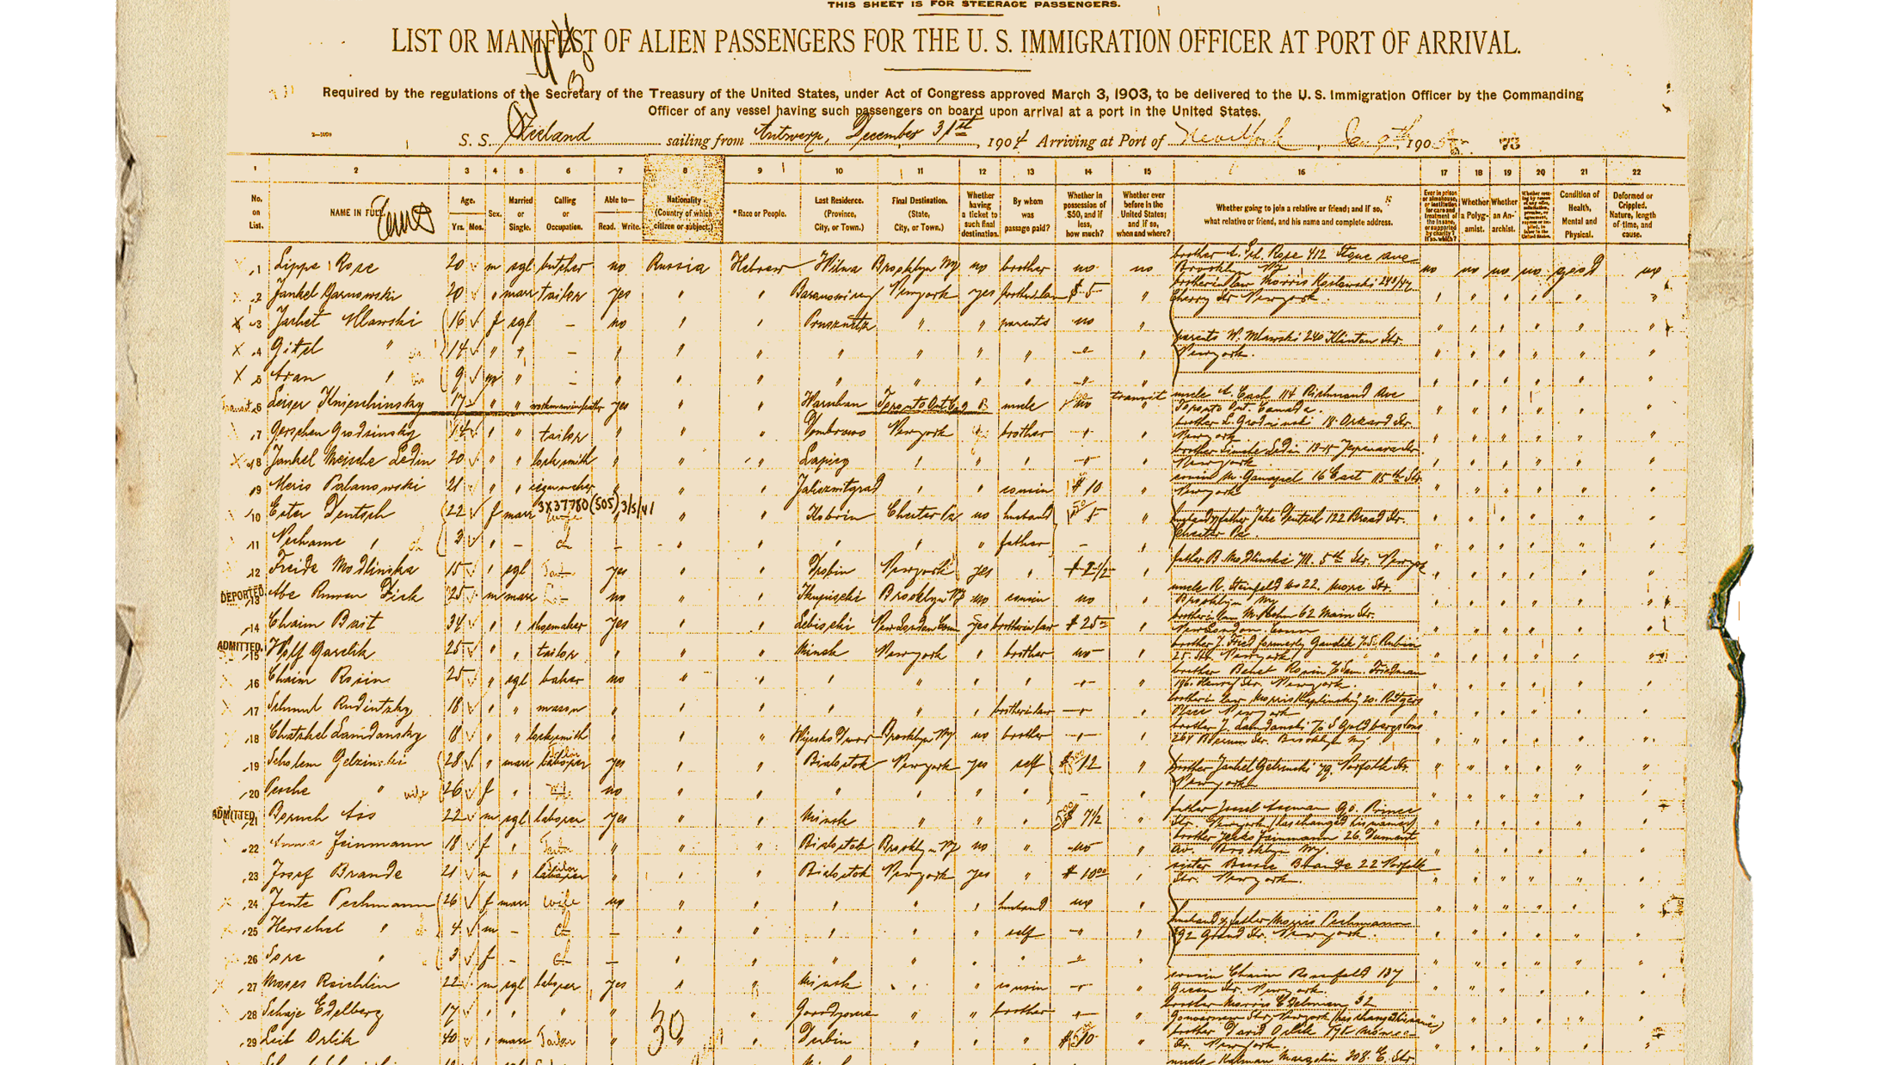
Shipping Manifest
Building
Building your code, with a container first mindset
Running
Prepare your code to run
Deploying updates to your code
Patching
Patching – the paradigm shift
Reaping the rewards of your efforts

Slide 3
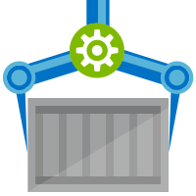


Release Management
Resource Pool
Orchestration
HOST-A
Deploy:
web:1 x3
api:1 x3
cache:1 x4
Image Cache
3
web:1
digest: 91e
web:1
digest: 91e
Foo:
web:1 x3
api:1 x3
cache:1 x4
web:1
digest: 91e
api:1
digest: u82
Container Builder
cache:1
digest: 2re
cache:1
digest: 2re
Container Registry
HOST-B
Image Cache
api:1
digest: u82
api:1
digest: u82
7
6
api:1
digest: u82
5
web:1
digest: 91e
api:1
digest: u82
cache:1
digest: 2re
api:1
digest: u82
cache:1
digest: 2re
1
cache:1
digest: 2re
docker build –t web:1
docker build –t api:1
docker build –t cache:1
docker push web:1
docker push api:1
docker push cache:1
cache:1
digest: 2re
cache:1
digest: 2re
Image
web:1
api:1
cache:1
2
Digests
91e
u82
2re
web:1
digest: 91e
HOST-C
api:1
digest: u82
4
cache:1
digest: 2re
8
Image Cache
api:1
digest: u82
api:1
digest: u82
cache:1
digest: 2re
cache:1
digest: 2re
Notes:
Orchestrator icon from: http://cdn.marketplaceimages.windowsphone.com/v8/images/f58edb21-b20c-4315-b837-6cee21n442cd?imageType=ws_icon_large
https://git-scm.com/book/en/v2/Git-Branching-Basic-Branching-and-Merging

Slide 4

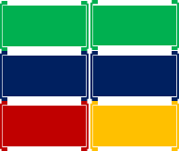
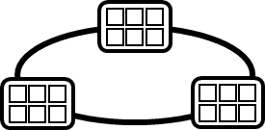

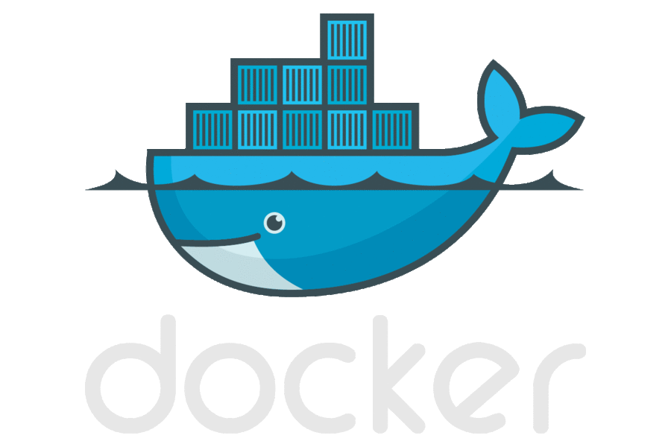
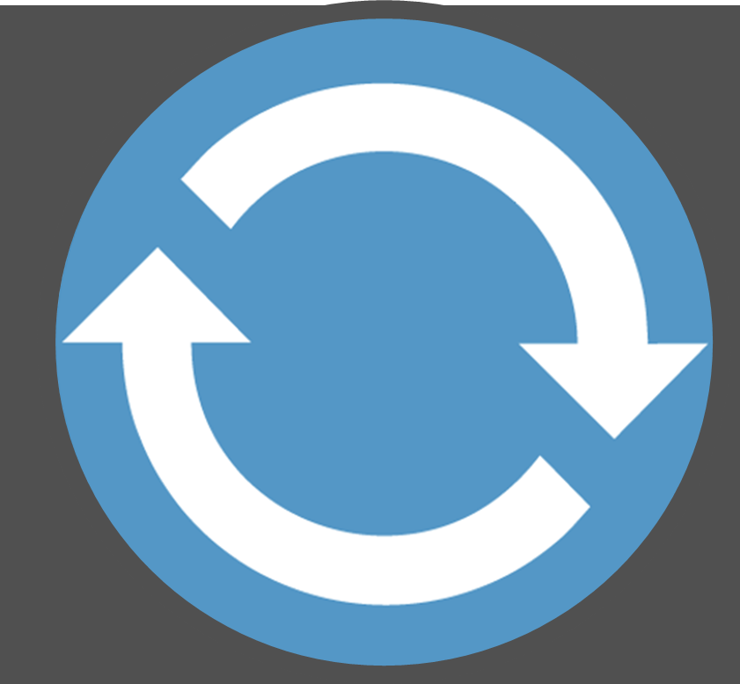

Today’s Container DevOps Workflow
Container Service
OS & Framework Patching
What happens when developers stop making code changes?
Run, Manage
Container Instances
Source Code Control
(SCC)
Build/CI,
Integrate,
Test
CD, Deploy
App Services
Production
environments
Service Fabric
SQL Data Services
coming soon
Inner-Loop
…
Run
Monitor and Diagnose
Code
Validate
Debug

Slide 5




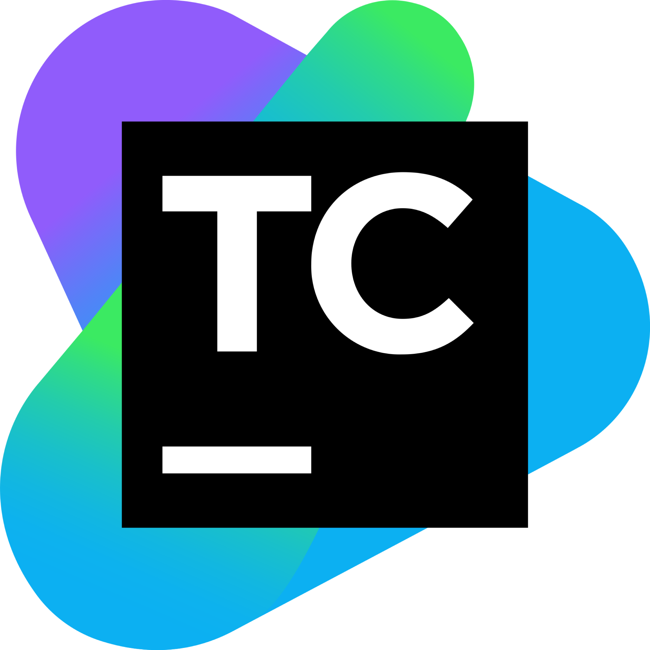

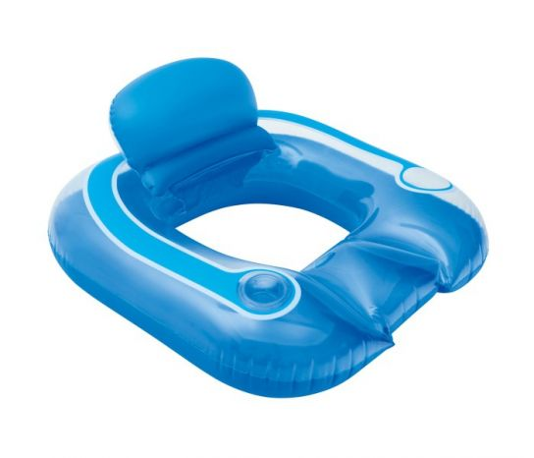

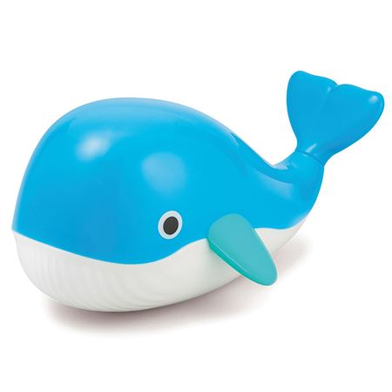



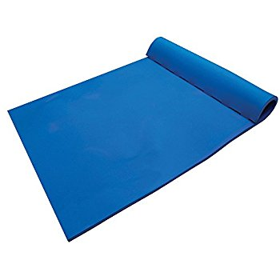
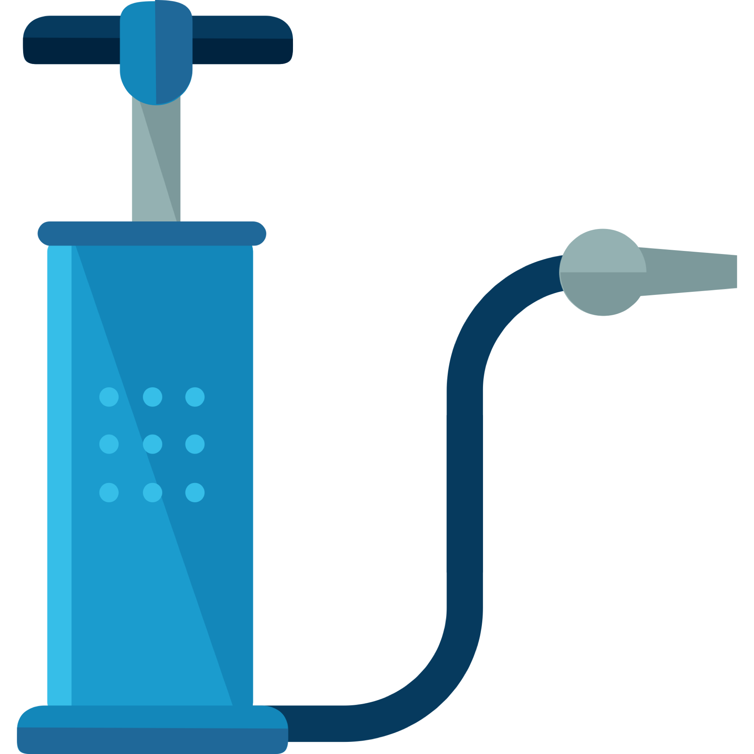


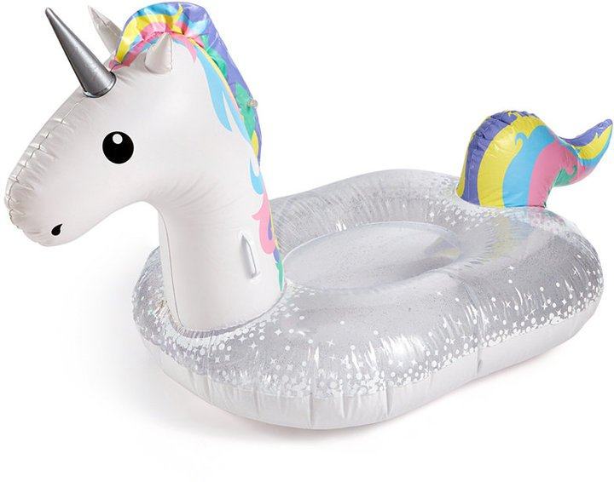



Current Build Infrastructure
Build, Integrate, Test
Hosted Build Agent Pool
Contoso – Build Pool
Northwind – Build Pool

Slide 6
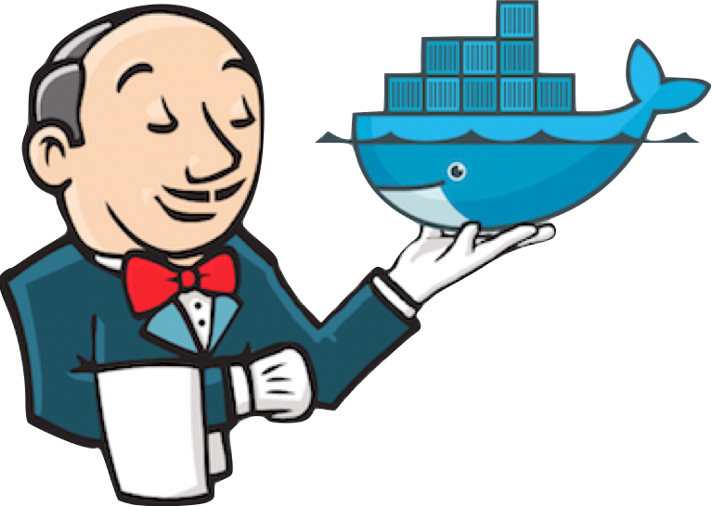
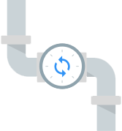


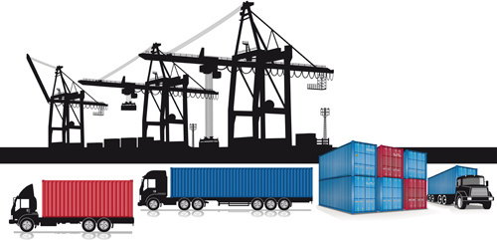
Native Container Builds
Build, Integrate, Test
Hosted Build Agent Pool

Slide 7
ACR Build
Container Build Service
Follows docker build semantics
docker build –t helloworld:v1 .
az acr build –t helloworld{{.Build.ID}} .
Inner-loop pre check-in validations
Trigger based builds (git commits, base image updates)
az acr build-task create –-image helloworld{{.Build.ID}}
--name myBuildTask
--registry jengademos
--context https://github.com/me/helloworld
--branch master
--git-access-token $PAT

Slide 8




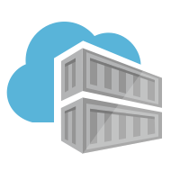


ACR Build: Container OS & Framework Patching
.NET
Registries
Docker Hub
MCR
ACR
Build Triggers
SCC Providers
ACR Build
Azure Container Registry
aka.ms/acr/build

Slide 9
Demo
ACR Build
Inner loop
trigger builds on git commits
but, wait, there’s more…

Slide 10
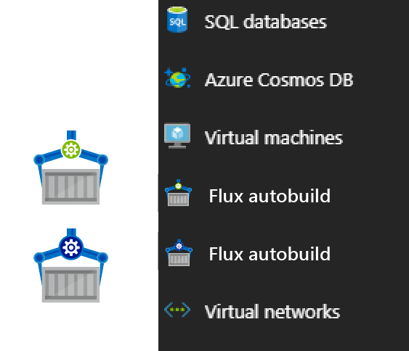

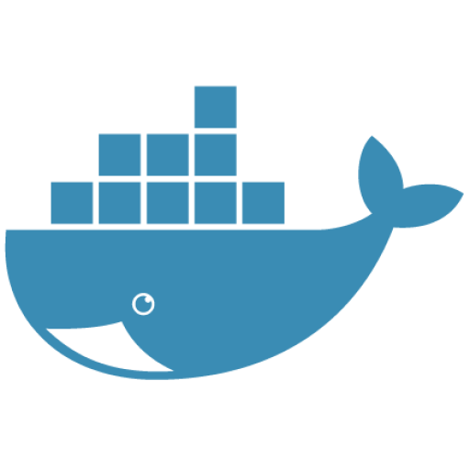

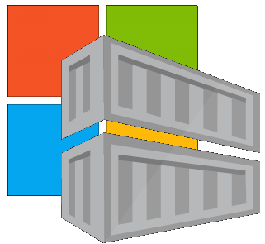
Contoso (Returns)
1 Pull Request
= 1 Build
= 1 Push
= 1 Scan
= 1 Test
= 1 Deploy
$$(1pr=1b+1p+ 1t+1d) ∗life of development$$
Contoso (*)
= 1 Build
= 1 Push
= 1 Scan
= 1 Test
= 1 Deploy
= 1 Build
= 1 Push
= 1 Scan
= 1 Test
= 1 Deploy
= 1 Build
= 1 Push
= 1 Scan
= 1 Test
= 1 Deploy
.NET
Northwind
= 1 Build
= 1 Push
= 1 Scan
= 1 Test
= 1 Deploy
= 1 Build
= 1 Push
= 1 Scan
= 1 Test
= 1 Deploy
= 1 Build
= 1 Push
= 1 Scan
= 1 Test
= 1 Deploy
Smart Hotel 360
= 1 Build
= 1 Push
= 1 Scan
= 1 Test
= 1 Deploy
= 1 Build
= 1 Push
= 1 Scan
= 1 Test
= 1 Deploy
= 1 Build
= 1 Push
= 1 Scan
= 1 Test
= 1 Deploy
Adventure Works
= 1 Build
= 1 Push
= 1 Scan
= 1 Test
= 1 Deploy
= 1 Build
= 1 Push
= 1 Scan
= 1 Test
= 1 Deploy
= 1 Build
= 1 Push
= 1 Scan
= 1 Test
= 1 Deploy
Fabrikam
= 1 Build
= 1 Push
= 1 Scan
= 1 Test
= 1 Deploy
= 1 Build
= 1 Push
= 1 Scan
= 1 Test
= 1 Deploy
= 1 Build
= 1 Push
= 1 Scan
= 1 Test
= 1 Deploy
$$1patch=cust ∗apps ∗ \left(1b+1p+ 1t+1d\right)∗life of the app$$

Slide 11

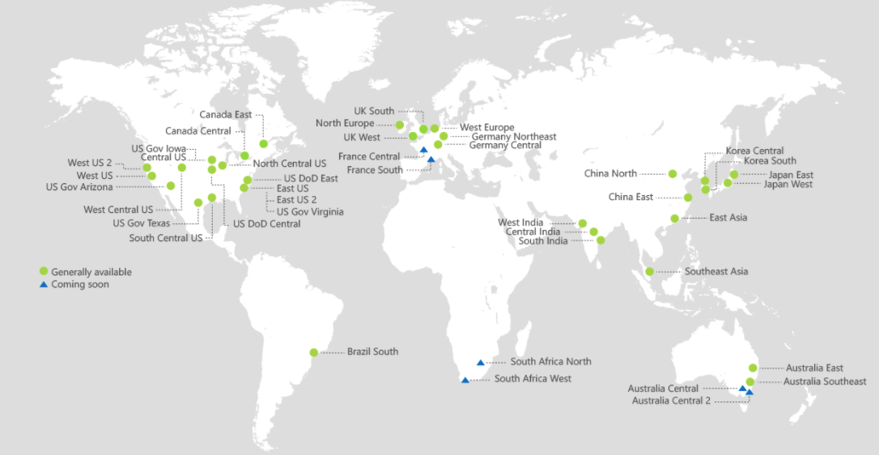
Azure Container Registry
Providing a single registry across the globe
aka.ms/ACR
aka.ms/ACR/Docs
aka.ms/ACR/Geo-replication
aka.ms/ACR/Roadmap

Slide 12
ACR Build
A capability of Azure Container Registry
aka.ms/acr/build
@SteveLasker
blogs.msdn.microsoft.com/SteveLasker
github.com/SteveLasker/Presentations
github.com/Demo42

